Slide 1
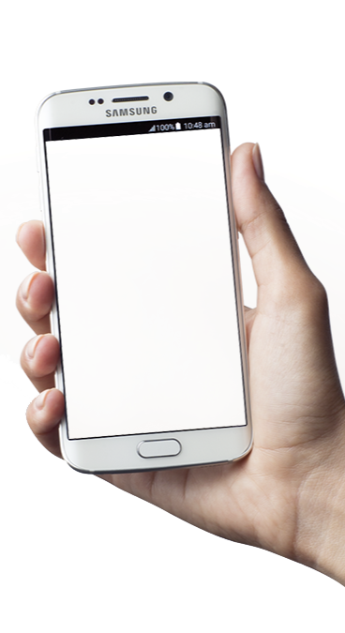

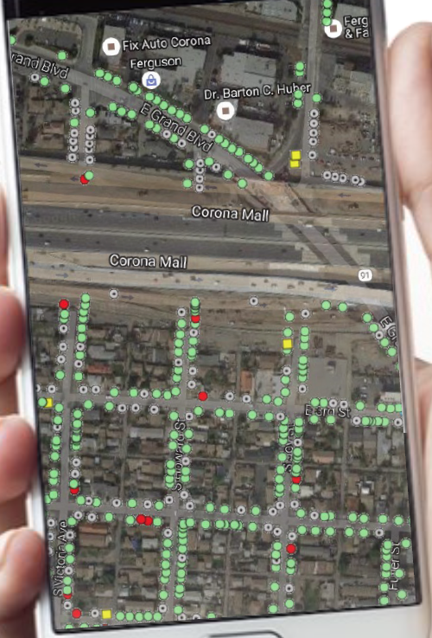
City of Corona
Urban Forestry Report
July 2021
1

Slide 2
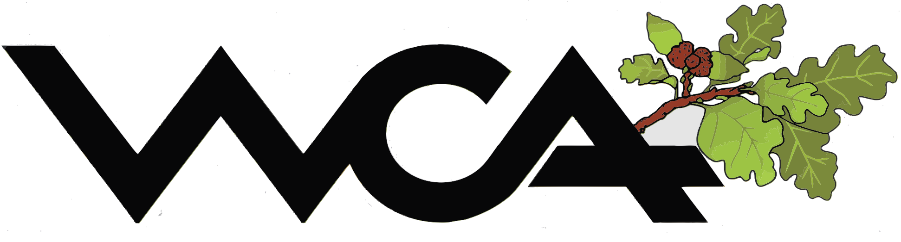
BENEFITS OF TREES
Trees provide the following benefits for the members of the community:
Trees are a Capital Asset:
The urban forest if well maintained may be the City's most valuable single asset of the infrastructure.
Trees Increase Property Value: Studies show that trees add up to 15% to residential property value and well landscaped commercial property is always in high demand.
Trees Reduce Pollution:
Trees trap and hold pollutants, absorb carbon dioxide and produce oxygen.
Trees Conserve Energy:
Trees cool neighborhoods in summer months and provide a windbreak during cold winter months resulting in less electricity demand for cooling and heating.
1

Slide 3
INVENTORY OVERVIEW
Data collection has determined that the City of Corona consists of 61,672 street trees, stumps, and vacant sites located in street rights-of-way, medians, and facilities. The information collected for each tree is listed below:
Tree Site Location
Tree Identification
Diameter Range
Utility Presence
Recommended Maintenance
Removal Priority
Height Range
Condition
1

Slide 4
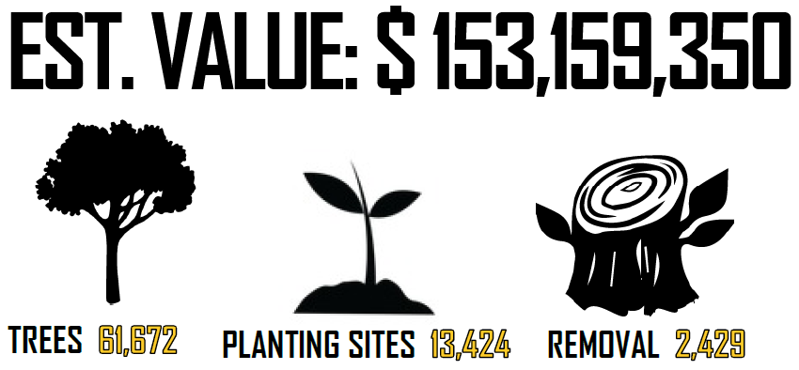



TREE INVENTORY SNAPSHOT
EST. VALUE: $ 157,843,050
TREES 58,416
PLANTING SITES 16,367
REMOVAL 2,085
1

Slide 5
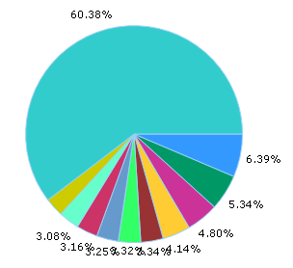
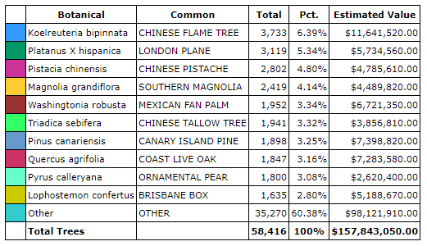
TREE INVENTORY SNAPSHOT
TOP 10 SPECIES
1

Slide 6
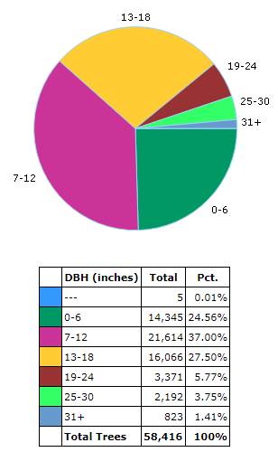
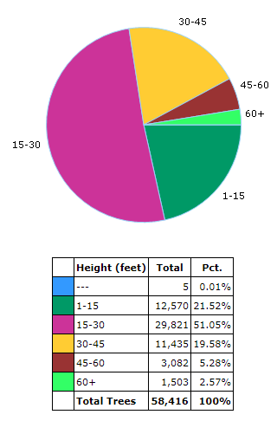
TREE INVENTORY SNAPSHOT
DBH
HEIGHT
1

Slide 7
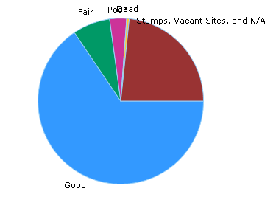
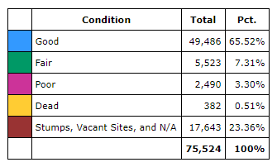
TREE INVENTORY SNAPSHOT
CONDITION
1

Slide 8
BENEFITS OF GRID TRIMMING
Benefits of Grid Trimming
Scheduling
Improved Public Relations
Equitable Service
Preventative Maintenance
Improve Health
Maintain Capital Asset
Reduced Liability*
Efficient Record Keeping
*Trees can present a serious safety concern, especially larger, mature trees. Because many municipalities assume responsibility for a safe public right-of-way, any negligence for the care of trees impacting the safety of the right-of-way may fall on the municipality. However, by implementing a comprehensive tree risk management program, the City can take steps to limit their liability while keeping the public safe.
1

Slide 9
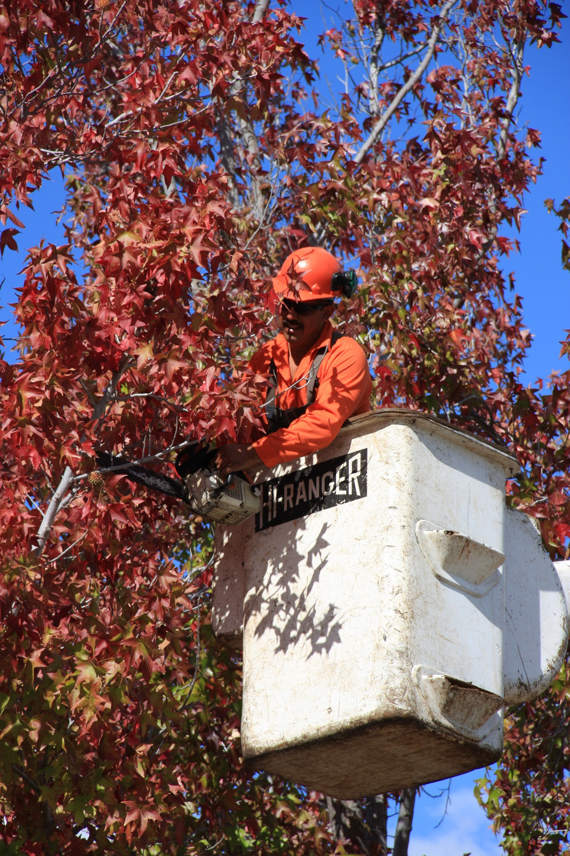
ABOUT TREE PRUNING
Tree Pruning
The optimal pruning cycle for a Southern California municipality is 3-5 years. By keeping the pruning cycle low the City is managing pro-actively, hedging against future liabilities associated with a deteriorating urban forest as well enhancing the value of a significant asset.
1

Slide 10
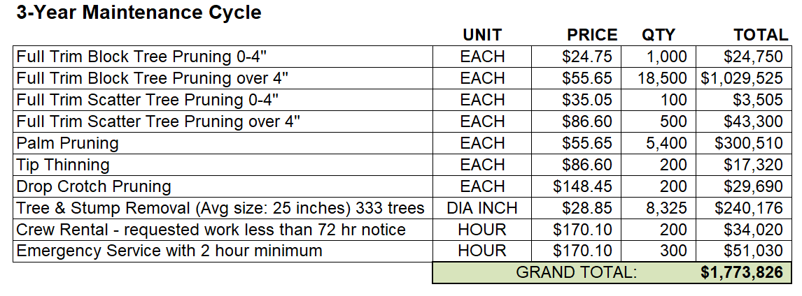
MAINTENANCE CYCLE
1

Slide 11
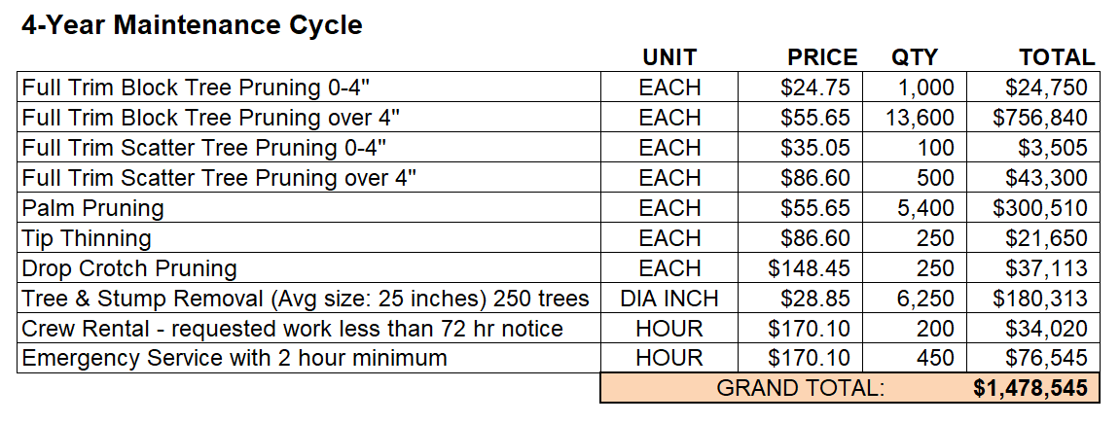
MAINTENANCE CYCLE
1

Slide 12
MAINTENANCE CYCLE
1

Slide 13
THANK YOU
1

